Slide 1






PYTHON BEGINNER COURSE
2024
2024
PYTHON
BEGINNER COURSE
Lesson 1
SHALEV LAU
/in/shalevl
/mushroomhater07

Slide 2
Introduction

Slide 3
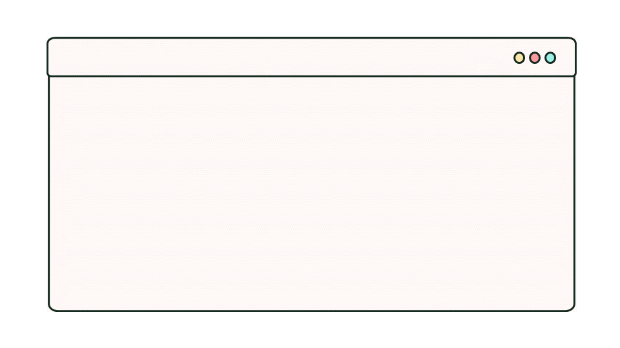



Thank you
University Life is busy.
We appreciate you spent your time wisely with us.
We hope you get the most out of this course.
By signing up for the course:
- You joined the community
- You get constant support from many other our experienced mentors
- You have help funded our social enterprises
OnTarget
CARTE
Vape Drop

Slide 4








Meet The Team
Rikzar
Rokas
Julian
Project Manager
Outreach
Project Manager
Amin
Izenith
Shalev
Financial
Project Manager
Program Developer
Nedjm
Haris
Jivanthika
Program Developer
Mentor
Mentor

Slide 5



Follow Our Social
Instagram @code_creators
- Keep you updated
- quick DM reply with queries relating to finance
- See what goes on at CC
Discord Server discord.gg/DX3S8EURz2
- Support from CC Mentors
- Private community for CodeCreators members
GitHub Resource
@ccsheff24
- Starter project files are here.
- Contribute to open source.

Slide 6
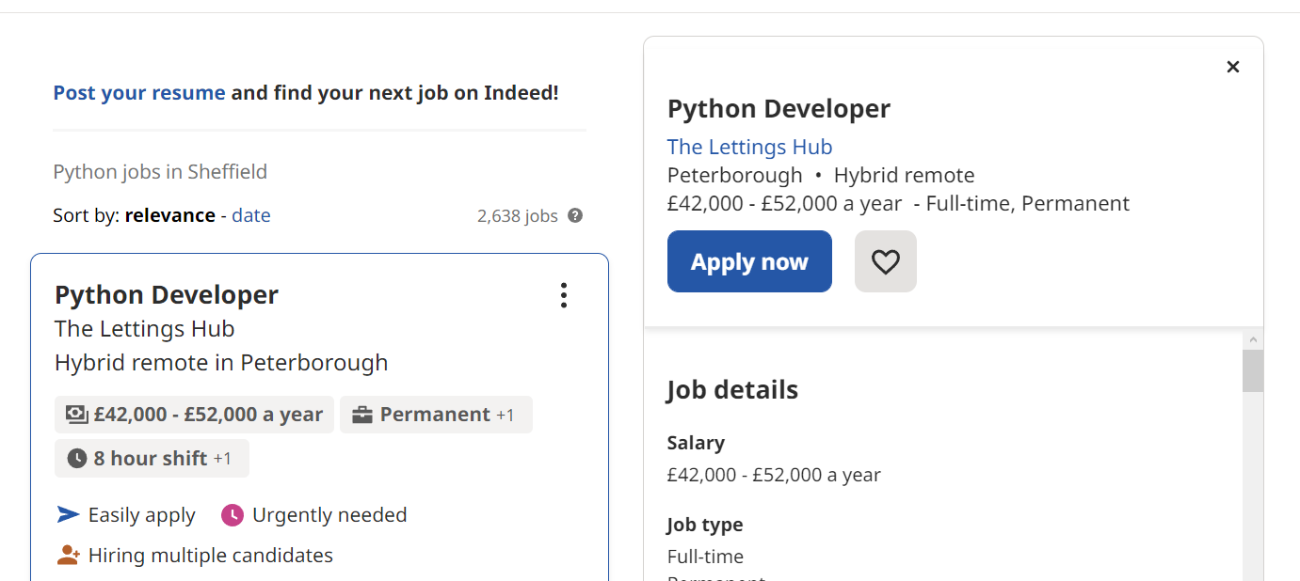
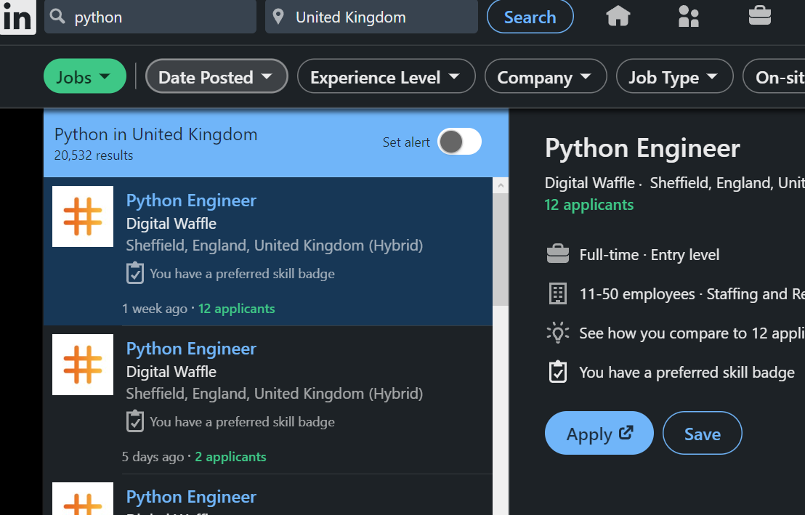
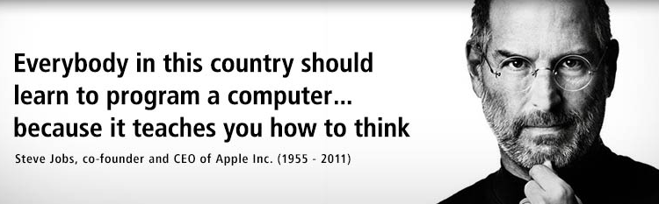
Why learn Python: EVERGROWING POPULARITY
26
(% SHARE IN 2022)
21
You won’t be
short of employment
after learning Python!
8.3
7.6
7.3
6.3
PYTHON
4
JAVA
JS
C#
C
PHP
R

Slide 7


Why learn Python: BEGINNER FRIENDLY
Python provides simple syntax to write your code. This is thanks to its indentation style, lack of triviality like terminating semi-colons or type definitions and a rich in-built standard library. Less time for errors, more time for coding!
PYTHON
C
# no import needed
print("Code Creators!")
#include <iostream>
using namespace std;
int main(int argc, char * argv[])
{
cout << "Hello, world!" << endl;
return 0;
}

Slide 8
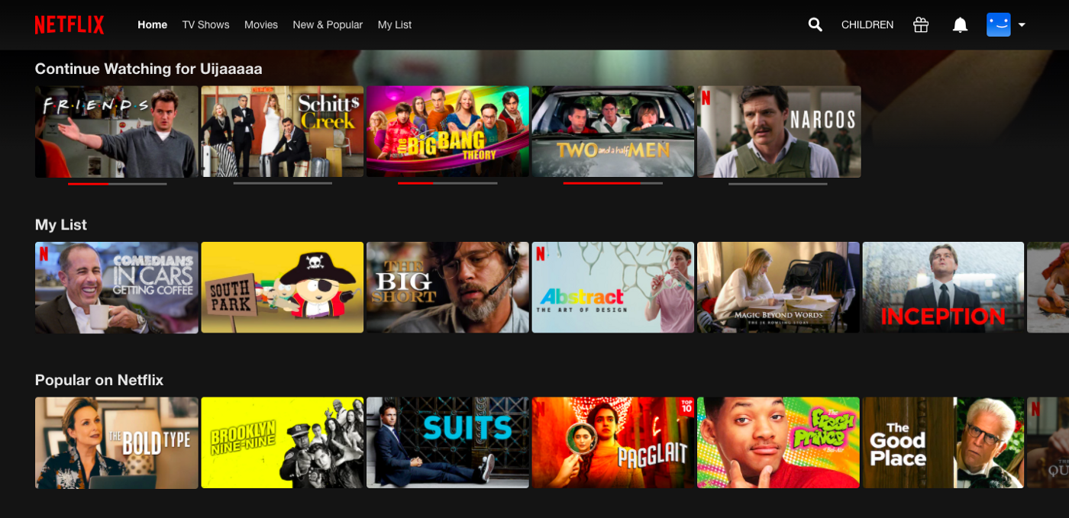


Why learn Python: RANGE OF APPLICATIONS
Web Dev
(Covered in the advanced course.)
• Make websites using frameworks like Django.
• Ability to handle asynchronous requests.
Big Data Analysis
• In-built features of supporting data processing for unstructured and unconventional data which is a common need in big data.
• Libraries like Pandas and SciPy aid with analysing data.
Machine Learning
• Plenty of libraries for ML like Keras, TensorFlow, and Scikit-learn for machine learning.
• Python acts an easier interface compared to Java etc.
• Python performs slower than C. Under the hood these libraries run on C anyway so it doesn’t matter.

Slide 9
Code editor / IDE setup
Throughout the rest of the course, we will use Visual Studio Code. However, you are free to use any code editor or Python IDE you want.
Recommended:
PyCharm
VScode
Thonny
Atom
IDLE (This comes with the express Python installation so no further setup is required. Simply search for "IDLE" in your start menu.)

Slide 10
Python Installation
For Windows:
winget install -e -i --id=Python.Python.3.11 --source=winget --scope=machine
For macOS:
Open the Terminal app and install brew /bin/bash -c "$(curl -fsSL https://raw.githubusercontent.com/Homebrew/install/HEAD/install.sh)"
Install python with: brew install python
Type nano ~/.bash_profile and press Enter.
Add the following line to the file: export PATH="$PATH:/Library/Frameworks/Python.framework/Versions/X.Y/bin"
Save the file by pressing Ctrl+O, then press Enter.
Close the file by pressing Ctrl+X.
Restart the Terminal app for the changes to take effect.

Slide 11
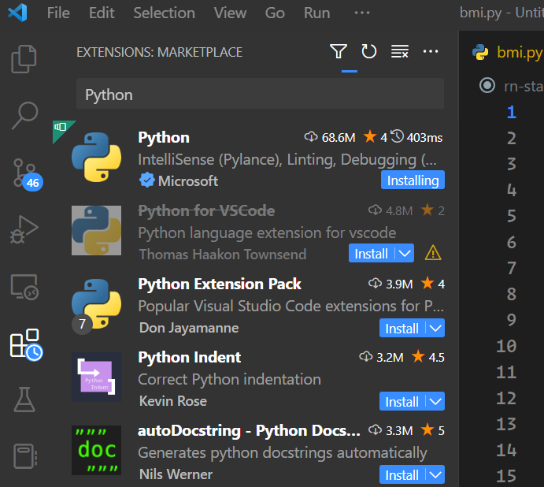
VS Code Installation and Extension Setup
For Windows:
winget install Microsoft.VisualStudioCode --override '/SILENT /mergetasks="!runcode,addcontextmenufiles,addcontextmenufolders"'
For macOS:
brew install --cask visual-studio-code
After Installation:
Click on the building blocks icon and search "Python" in the search bar and install the first extension that comes up. This gives us features like below and more. Feel free to add any other extension which you may find useful.
IntelliSense (Pylance)
Linting
Debugging
Code formatting
SEARCH
INSTALL
CLICK

Slide 12
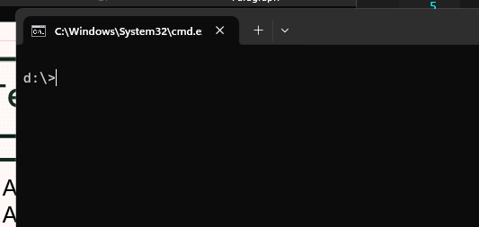
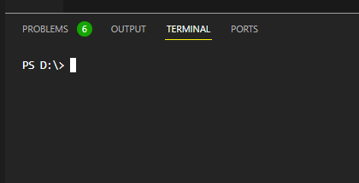
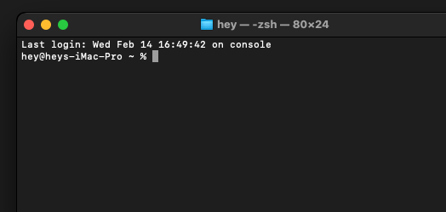
Terminal
A window where user interact with the operating system
A text-based console application by entering text input through the computer keyboard
and reading text output from the computer terminal.
Windows console is called the command prompt window & accepts MS-DOS commands.
macOS terminal accepts zsh commands, similar to sh command in Linux.

Slide 13
PYTHON BEGINNER COURSE
2024
2024
PYTHON
BEGINNER COURSE
Lesson 1
SHALEV LAU
/in/shalevl
/mushroomhater07

Slide 14
Lesson 1 - Content

Slide 15
Data Types
Data types define a possible set of values and what operations can be done on them. Typically languages have primitives (basic data types from which all other data types are constructed).
In the case of Python every value is an object but don’t confuse this for an object type.
Data Types | Python Classes | Example | Description
Numeric | int, float, complex | 20, 20.5,2+5j | holds numeric values
String | str | "apple" | holds sequence of characters
Sequence | list, tuple, range | ["apple", "banana“] ("apple", "banana“) | holds collection of items
Mapping | dict | {"name" : "John", "age" : 36} | holds data in key-value pair form
Boolean | bool | True, False | holds either True or False
Set | set, frozeenset | {"apple", "banana“} | hold collection of unique items
Binary | bytes, bytearray, memoryview | b"Hello" | Hold binary (non-printable) data
number = 20
fruit = "pear"
print(type(fruit))
# type <class‘string’>

Slide 16
Arithmetic operations
Python follows the traditional mathematical operations and rules of precedence (BIDMAS).
If you ever need to do an operation on an existing variable you can put the operator in front of the assignment syntax.
Operator | Operation | Example
+ | Addition | 4 + 2 = 6
- | Subtraction | 5 - 3 = 2
* | Multiplication | 4 * 2 = 8
** | Exponent | 4 ** 2 = 16
/ | Division | 7 / 2 = 3.5
// | Floor (or Integer) division | 7 / 2 = 3 # 3.5 rounds to 3
% | Modulus | 7 % 5 = 2
x = 20
x = x / 2
print(x) #10
x = 20
x /= 2
print(x) #10
=

Slide 17
Variable & constant
Variables work like they in maths, they store some value in memory.
What we just wrote is known by 3 names which are used interchangeably but incorrectly. Only one of them is technically correct in the context of Python.
Variable declaration - Declaration just specifies the type but doesn't allocate memory.
Variable definition – Definition associates the variable with a type and allocates memory.
Variable assignment – The name on the left-hand side now refers to the result of evaluating the right-hand side, regardless of what it referred to before (if anything)
The name given to the variable is called Identifier
fav_website = 'apple.com'
fish = 2

Slide 18
Type Casting
Unlike other languages like JavaScript, Python prefer explicit is better than implicit. That means Python won't automatically type casting.
We also have to (explicitly) convert types so that they’re compatible with each other.
num1 = int(“5”)
num2 = int(-2.8)
num3 = float(“5”)
print(num1) # prints 5
print(num2) # prints -2
print(num3) # prints 5.0
print("It's " + 11 + "AM")
# TypeError: can only concatenate str (not "int") to str
print("It's " + str(11) + "AM")
# It’s 11 AM

Slide 19
Python I/O
We can use print keyword to output to terminal and get user input using input to assign a variable
print statement will automatically create a newline. To avoid this, we can add an argument end = '' before the closing bracket
input statement pauses execution of the program until Enter key is pressed. It takes 1 optional argument for the prompt
print("Is GTA", 6, "released?", False)
# Is GTA 6 released? False
print("hello", end = '')
print("world")
# helloworld
#
name = input("Enter your name: ")
print(name)
# Enter your name: James
# James

Slide 20
Python Identifier
The name that given to a variable and function are named as identifier
There are special rules:
They cant be python keywords (True, False, None, print)
They are case-sensitive ( Animal & animal are different variable
Whitespace is not allow ( calculated answer ➔ calculated_answer )
Cannot use special symbol (e.g. !, @, #, $)
Begin with letter or _ .Cannot start with digit ( 1name )
👍 Good
Name
is_complete
num_of_people
😡 Bad
lMAao!
😱
1st_variable

Slide 21
Comment
You might notice hash(#) symbol in the previous example. In python, it is for writing a single-line comment.
You can also write multiline comment by ("""). This usually appear at the front
Comment can be used to
Explain code
Make code more readable
Prevent execution when testing
"""
Written on 2024
Version 1.0
"""
fruit = "apple"
# assignment used
Shortcut key for most text editor:
Ctrl + / if you are on Windows
Cmd + / if you are on a Mac.

Slide 22
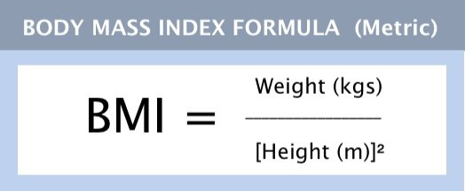
Variable & constant
BMI is a way to figure out your approximate level of body fat in an easy, inexpensive way. I’m going to make it slightly harder for you because I want you to accept the user height in centimetres.
BMI Calculator
Enter your height in cm: 180
Enter your weight in kg: 75
Your BMI is: 23.148148148148145

Slide 23
Variable Scope
Local
accessible only from the method or block in which it is declared
Global
used throughout the program
it is not always desirable to use global variables in complex programs
Because it can be easy to change the value by accident

